Slide 1
MALIGNANT COMMENT CLASSIFIER
John Tojo
Data Science Intern

Slide 2
Overview
Introduction
Problem Statement
Exploratory Data Analysis (EDA)
Observations from graphs
Data cleaning
Model Selection
Conclusion
Future Work

Slide 3
Introduction
Classifying ham and spam is an important task that helps us to filter out unwanted or malicious emails. In today's digital age, electronic communication has become a crucial part of our personal and professional lives. However, this has also made us vulnerable to spam emails, which are unsolicited and often contain malicious content such as scams, phishing attacks, or viruses.
Classifying emails as either ham (legitimate) or spam (unwanted) helps us to protect ourselves from these threats by automatically directing spam emails to a separate folder or deleting them altogether. It also improves the overall efficiency of our email systems by reducing the amount of time we spend sifting through and deleting spam emails.
In this report, we will discuss the various methods for classifying ham and spam, including machine learning algorithms and the approach used to solve the problem. We will also examine the importance of accurately identifying spam emails in order to protect ourselves and our inboxes from unwanted and potentially harmful content.

Slide 4
Problem Statement
The problem of spam emails is a pervasive one that affects individuals and organizations alike. Spam emails can be a nuisance, clogging up our inboxes and taking up valuable time that could be better spent on more important tasks. Moreover, spam emails can also pose a serious threat to our security and privacy, as they often contain malicious content such as scams, phishing attacks, or viruses.
As a result, there is a need to classify ham and spam in order to protect ourselves from these threats and improve the efficiency of our email systems. However, accurately identifying spam emails can be a challenging task, as spam emails are constantly evolving and becoming more sophisticated. There is also the risk of false positives, where legitimate emails are mistakenly classified as spam.
Given these challenges, it is important to carefully consider the various methods for classifying ham and spam and to continuously update and improve these methods as the spam landscape changes

Slide 5
DATA SOURCES AND THEIR FORMATS
The data was provided by FlipRobo in CSV format. The dataset had 5 columns and 5572 rows
v1: which takes values spam or ham
v2: text
Unnamed: 2, Unnamed: 3, Unnamed: 4 mostly have null datas

Slide 6
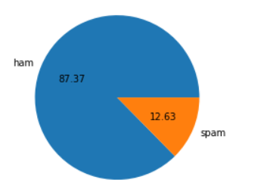
Exploratory Data Analysis (EDA)
Step 1 Check for info on the data frame and dropped columns Unnamed: 2, Unnamed: 3, Unnamed: 4 have more than 60% of data as null
Step 3 used pie plot to see the distribution of spam and ham, observed that data set was imbalanced
Step 4 Created new columns with name: num_characters, num_words num_sentences which stores no. of characters, no. of words and no. of sentences in the text column
Step 5 text were cleaned by first converting to lower then by removing punctuation and stop words after which it was stemmed and joined and stored in a new column called transformed_text, after which the target column was encoded
Step2 :
renamed columns v1 to target and v2 to text
Checked for duplicates and dropped duplicates accounted for 7% of the whole data

Slide 7
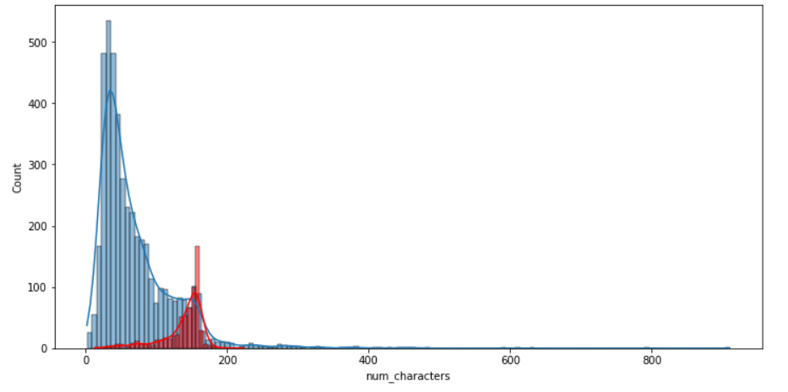
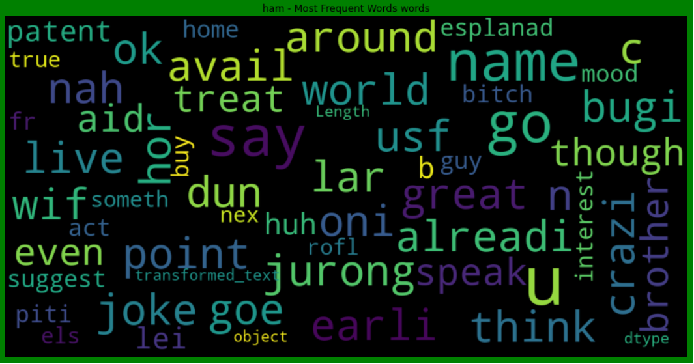
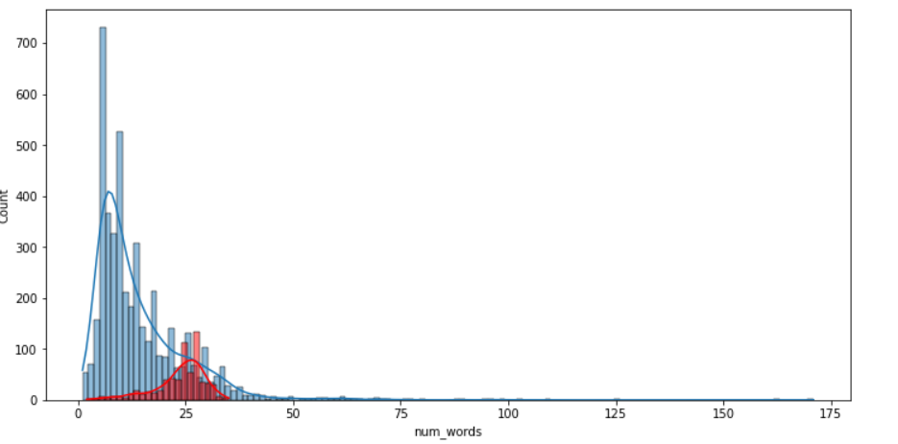

Visualization
Fig1: count vs num_characters
it can be seen that spam has more characters present than ham
Fig3: showing word cloud for ham
Fig2: count vs num_words
it can be seen that spam has more characters present than ham
Fig4: showing word cloud for spam

Slide 8
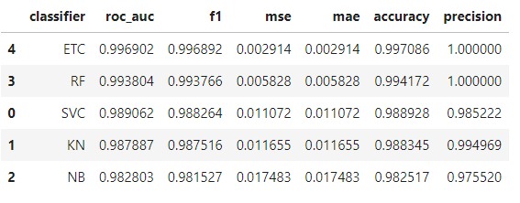
Model Selection
The stemmed text was then vectorized using TFIDF with max features of 5000 as the dataset was imbalanced it was balanced using smote
The problem was classification problem as the target variables would take value 0 or 1
The different models used were as follows:
SVC
MultinomialNB
KNeighborsClassifier
RandomForestClassifier
ExtraTreesClassifier
The parameters used to determine the
best models were as follows:
Roc_auc
F1 score
Mse
Mae
Accuracy
Precision
ETC is the best model
highest roc_auc area
highest accuracy and precision
least error in mae and mse
least value for FP and FN compared other models

Slide 9
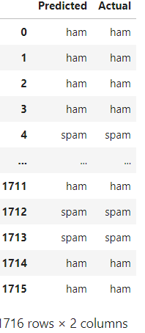
Predictions
The model was first saved in pkl format
The model was loaded and then x_test was used for prediction and stored in predictions
The prediction were done on test dataset and stored into a data frame predictions_df

Slide 10
Conclusion
machine learning algorithms to classify the spam and ham
the data provided had small amount of spam data hence need to train the model using more such data in order to work efficiently

Slide 11


